Slide 1

Customer Lifetime Value (CLV) Analysis
Segmentation and Strategic Insights
Presented By :
Dakshini S

Slide 2
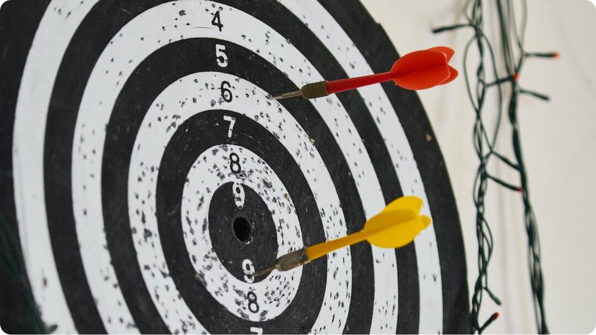
Project Objective
Customer CLV Segmentation Goals
Understand Behavior: Use CLV to analyze customer patterns
Segment by Value: Group customers into value-based tiers
Retention Strategies: Grow and retain high-value segments
Photo by engin akyurt on Unsplash

Slide 3

Dataset & Tools
Data Source and Analytical Platform
Dataset: Online Retail Dataset (UK e-commerce transactions)
Tools: Python (Pandas, NumPy, Matplotlib), Tableau, Excel
Platform: Analysis conducted in Jupyter Notebook
Photo by Lachlan Donald on Unsplash

Slide 4
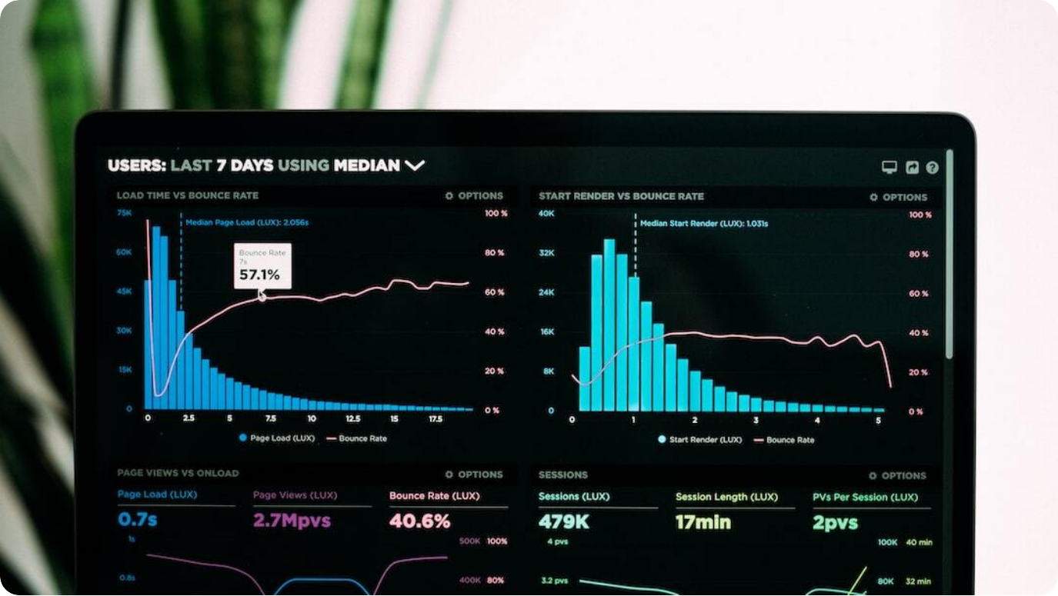
CLV Metrics & Distribution
Customer Value Spread Analysis
CLV Histogram: Distribution of CLV values across all customers
Skewed Distribution: Most customers fall in the lower CLV range
Key Insight: High CLV customers are rare but valuable
Photo by Luke Chesser on Unsplash

Slide 5

Customer Segments
CLV-Based Tier Distribution
Segment Groups: High, Mid-High, Mid-Low, Low
Distribution Insight: Most customers in Mid/Low segments
Segment Basis: CLV from purchase frequency and value
Photo by Missy Meyer on Unsplash

Slide 6



Segment Characteristics
Recency and Frequency by Tier
High CLV
Frequent and recent buyers
Mid Segments
Moderate activity and recentness
Low CLV
Infrequent and old transactions

Slide 7



Strategic Recommendations
Retention Actions by Segment
Low CLV
Win-back campaigns, re-engagement emails
Mid-Low
Loyalty points and follow-up programs
High CLV
VIP benefits, early access, priority support

Slide 8

Conclusion
Strategic CLV Segmentation Summary
Targeted Marketing: Segmentation helps focus on value-driving segments
ROI Impact: Improved retention boosts profitability
Dashboard Option: Tableau dashboard enables dynamic data review
Photo by The CEO Kid on Unsplash

Slide 9

Thank You!

